Slide 1
微軟雲端技術分享 -開南大學導入 Azure 打造零抱怨網路選課系統
盧凱平
教育事業協理
公共業務事業群
台灣微軟

Slide 2
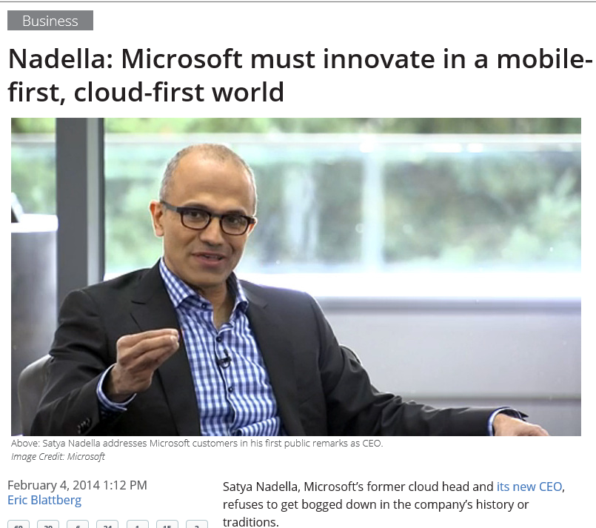

Slide 3
Microsoft Cloud
Software As A Service
Infrastructure As A Service
Platform As A Service

Slide 4
Consistent experiences across the Cloud OS
Microsoft Cloud OS
Microsoft Data Center
Windows Azure Pack
Windows Azure Pack
Services Provider Data Center
Enterprise Data Center

Slide 5
Microsoft Azure 跨國資料中心
北美洲
North-central US - Chicago, IL
South-central US - San Antonio, TX
West US - California
East US – Virginia
亞洲
East Asia - Hong Kong
South East Asia – Singapore
歐洲
North Europe - Dublin, Ireland
West Europe - Amsterdam, Netherlands
大洋洲 (2014 H2)
Sydney, New South Wales
Melbourne, Victoria
日本
Tokyo
Kansai
南美洲 (2014 H2)
Sao Paulo , Brazil

Slide 6
Microsoft Azure 與各項資安標準
國際標準 | 描述 | 認證狀態
EU-US Safe Harbor Framework | 歐盟對美國資料隱私規範 | 完成
ISO27001 | ISO 國際資安標準 | 完成 (core services)
PCI DSS Level 1 | 支付卡產業資料安全標準 | 完成 (core services)
SSAE 16 (SOC 1 Type 2) | 美國會計與稽核規範，取代 SAS 70 Type 2 | 完成 (core services)
FISMA / FedRAMP | 美國聯邦資訊安全管理法案 Federal Information Security Management Act (FISMA) | 完成 (GFS Datacenter)
EU Model Clauses | 處理歐盟資訊傳遞至美國相關規範 | 完成 (core services)
HIPAA BAA | 美國醫療資訊隱私保護規範 | 完成 (core services)
FISMA
ISO
SSAE
HIPAA
Core Services: Compute, Storage, Virtual Network, Virtual Machine

Slide 7
Microsoft Azure
自我持有
資料中心
Virtual Machines
Cloud Services
Web Sites
Applications
Applications
Applications
Applications
Data
Data
Data
Data
Firewall
Firewall Rules
Firewall Rules
Network
Virtual Network
Virtual Network
O/S
O/S
Virtualization
Hardware
專注於應用系統
Notes:
Slide Objectives:
Explain the differences between traditional self-hosting and the three options of Windows Azure hosting.
Notes:
In a traditional environment you must manage the full stack. With Windows Azure you can choose a variety of options depending on your needs.

Slide 8
virtual machines
支援 Windows Server 與Linux
彈性調整運算需求
支援虛擬私有網路 VPN (Virtual Private Networking)

Slide 9
虛擬機器可攜性
virtual machine portability

Slide 10
Microsoft Azure
您的資料中心

Slide 11
Extend your infrastructure
Windows Azure
Windows Azure Infrastructure Services
Virtual Machines with on-demand scale & compute
Spin up and tear down in minutes, no hardware provisioning
Connect with on-premises Active Directory and domains
Integrates Windows Azure Virtual Networks
Use what you know, manage with System Center
Integrates with Azure Platform, Apps, and Storage Services
Virtual Network
Active Directory
SharePoint
SQL Server
Internet
Your Datacenter

Slide 12
Extend your infrastructure
Windows Azure Infrastructure Services
Windows Azure Virtual Network
Logical isolation with control over network
Create Subnets, Private IP addresses
Bring your own DNS
<subnet 1>
<subnet 2>
<subnet 3>
DNS Server
Virtual Network
Notes:
Extend your Datacenter
Own the base, rent the rest! Extend your datacenter by building capacity on-demand.
With Windows Azure, you can literally create a virtual “datacenter” in the Cloud. You can do this by leveraging a feature called Virtual Network (VNET) which allows you to create a logically isolated section of Azure and treat it like your own network. You can customize the network configuration for a VNET - create subnets, assign private IP addresses and bring your own DNS server if you wish. Within a virtual network for example, you can create a public-facing subnet for your webservers that has access to the Internet, and place your backend systems such as databases or application servers in a private-facing subnet with no Internet access.

Slide 13
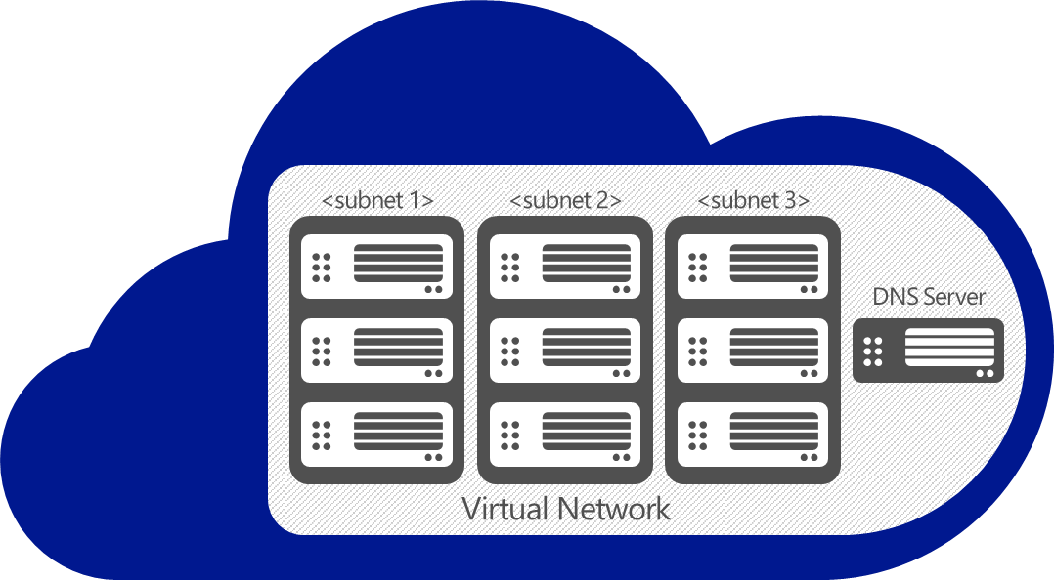
Extend your infrastructure
Windows Azure Infrastructure Services
Virtual Network as your Datacenter extension
Create Subnets, Private IP addresses
Bring your own DNS
Domain join your VMs
VPN
On-premises
VPN
Notes:
Of course, once you set up VPN connectivity, you’re treating the virtual network in Azure almost as if it were an extension of your on-prem datacenter. You can domain join your VMs with an AD running on-premises or an AD running inside of the virtual network. You can have hybrid multi-tier apps with perhaps the presentation and logic tiers running in Azure, and the database tier running on-premises for compliance reasons.
A good example is SharePoint that uses all of the features we outlined (cross-premises VPN connectivity, Active Directory, VMs).
Windows Azure provides first party tested Windows Server images for easily deploying SharePoint, SQL and Active Directory.
<From IaaS scenario for Sharepoint>
When you need more from your collaboration infrastructure vs. Office 365 and the ability scale in real time, count on Windows Azure. Start with dev & test work and maintain control as you grow. You can deeply customize with full trust custom code on top of Windows Azure infrastructure services. Support provided directly by Microsoft.
Internet sites with SharePoint: When you need to roll-out customized public or anonymous internet sites, count on Windows Azure. You can closely manage your infrastructure versus Office 365 and get real time scalable resources vs. on-premises datacenters. Get started quickly with direct Microsoft supported images.
<From IaaS scenario for AD>
Identity with AD in Virtual Machines
Hybrid apps and hybrid IT: When apps live both in the cloud and on-premises, and need to synch with on-premises directory, simply bring DirSync into Virtual Machines.
Specific AD capabilities in the cloud: When applications in need of on-premises optimized AD capabilities are moving to cloud and Windows Azure Active Directory is not the solution, bring your AD into Virtual Machines. Same AD, same skill sets and same trustworthy capabilities.
Identity synch with Office 365: When you need to synch identity with O365 and want to minimize your on premise identity infrastructure, rely on running AD in Virtual Machines. Even when you have an on-premises identity infrastructure synching with Office 365, simply build your high availability copy in Virtual Machines and keep working when internet connectivity is down.
<From IaaS scenario for Scalable, On-Demand Infrastructure For .NET apps>
When you need to accommodate variable and increasing needs of .NET and Windows Server apps, spin up trustworthy infrastructure with no code changes required. And, it is more than just infrastructure. Use Windows Azure building blocks – such as Service Bus or Media Services and many more from partners in Windows Azure Store – to boost your existing app.
When you want to participate in software as a service business model as an app vendor and host all or part of an existing .NET or Windows Server app in the cloud with no changes, build your offer on scalable, trustworthy Windows Azure infrastructure.

Slide 14
Extend your infrastructure
Windows Azure
Your Workloads and Infrastructure Services
Design, implement, and develop on SharePoint 2010/2013 without hardware
Develop custom internet sites and collaboration apps
Apps with public web front ends, variable traffic or sit in a demilitarized zone
Custom apps, Specialty Servers running workloads with periodic spikes
Virtual Network
Active Directory
SharePoint
SQL Server
Internet
Existing Datacenter
On-premise

Slide 15
其他應用
big data
資料庫
儲存體
流量管理
快取
服務匯流排
身分驗證
影音媒體
行動服務
網路整合

Slide 16
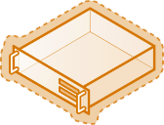
Windows Azure Pack可快速建立自助雲端平台
Management Portal/API
Management Portal/API
Web sites
VM
Service bus
Web sites
VM
Service bus
公有雲
私有雲
服務全世界客戶
運算資源集中在微軟機房
服務公司/機關/學校內部營運單位
運算資源集中在IT機房

Slide 17
Windows Azure Pack使用情境
管理介面Management Portal
自助式服務Self-service user experience / OData REST API
Web sites
Virtual machines
Service bus
Virtual Networks
Database
網站雲 (PaaS)
虛擬機器雲(IaaS)
可信任的訊息傳遞
虛擬網路
SQL資料庫雲

Slide 18
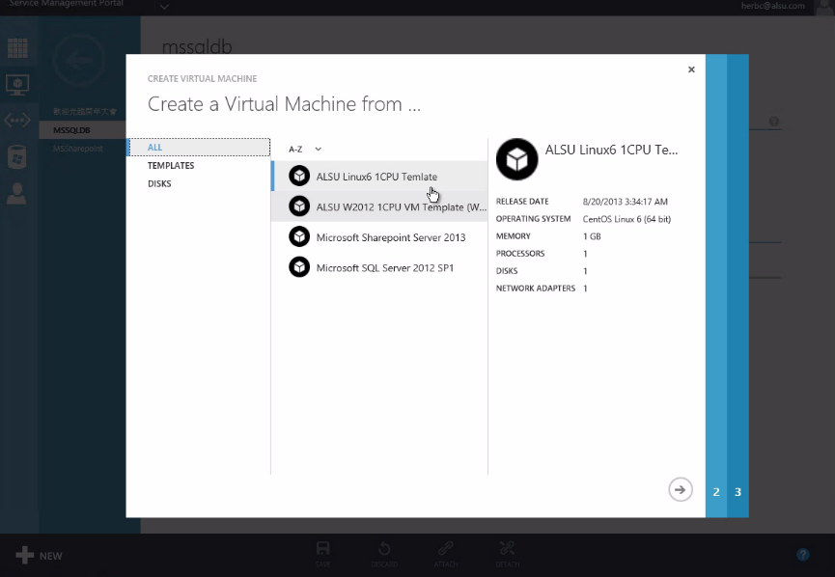
自助式雲端服務平台
- 可依使用者需求設定可存取的VM範本:
硬體設定檔
資料庫
網站
-快速產生用戶所需環境

Slide 19
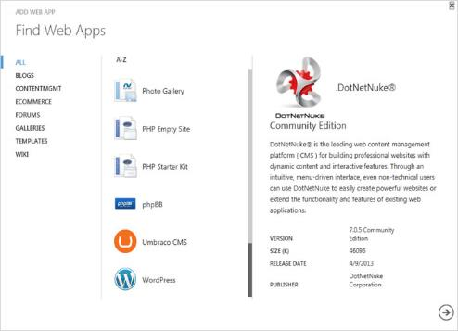
開發人員可使用此平台產生網站

Slide 20
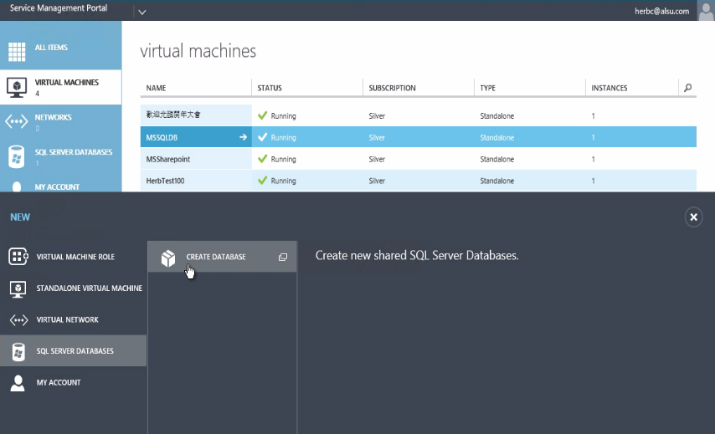
資料庫人員可使用此平台產生Database
-開發人員不需再顧慮底層環境
-直接可建立資料庫與網站
-IT集中控管所有資源

Slide 21
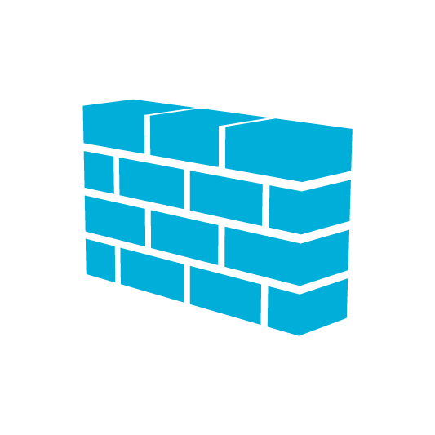
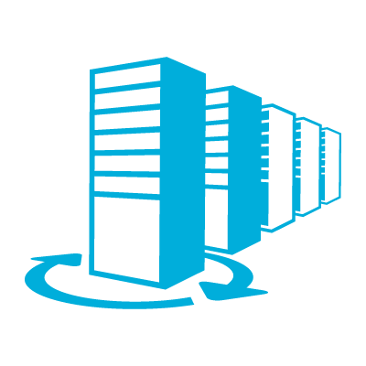
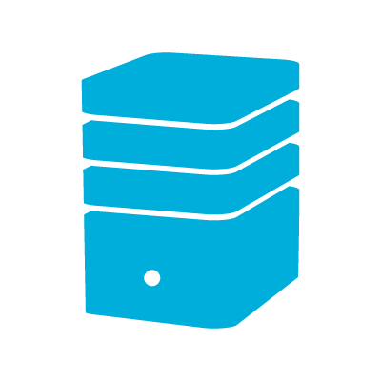
案例分享:
開南大學導入 Azure 打造零抱怨網路選課系統
Devices
On Premise
A10 GLBS
Web Front-End
Database
Web Front-End
Azure
On Premise
VPN
Notes:
http://www.knu.edu.tw/knu/page/POR/news_inside.aspx?SNO=1985

Slide 22
